Slide 1
Natural Language Processing for Question Answering and Machine Reading Comprehension
Ryan.nguyen (Minh-Tien Nguyen)
ryan.nguyen@cinnamon.is
NLP Team
July 2020

Slide 2
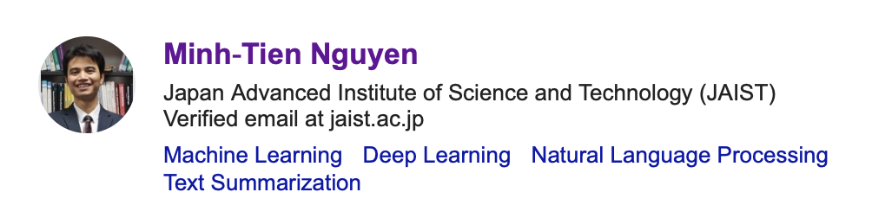
information
2012-2014: Master student, UET, VNUH
2013-2014: Visiting Researcher, National Institute of Informatics (NII), Japan
2015-2018: PhD candidate, Japan Advanced Institute of Science and Technology
October 2018-now: senior AI researcher at Cinnamon
Site: https://sites.google.com/site/minhtienhy/

Slide 3
information

Slide 4
information

Slide 5
Agenda
Introduction to NLP
Question answering (QA) and Machine Reading Comprehension (MRC)
Relevant Techniques
Text pre-processing
Question analysis
Information retrieval
Answer generation
QA and MRC with Deep Learning
Conclusion

Slide 6
Introduction to NLP

Slide 7
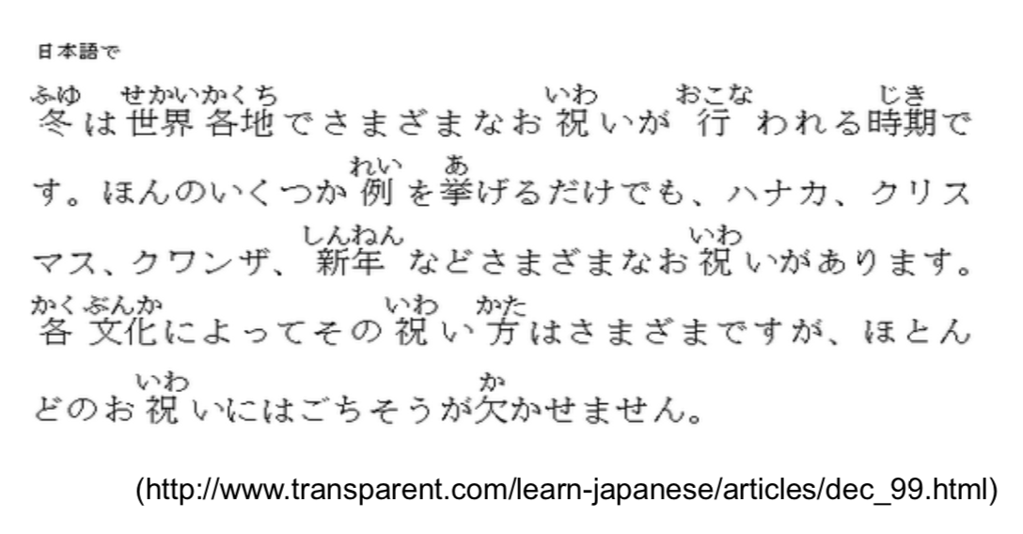
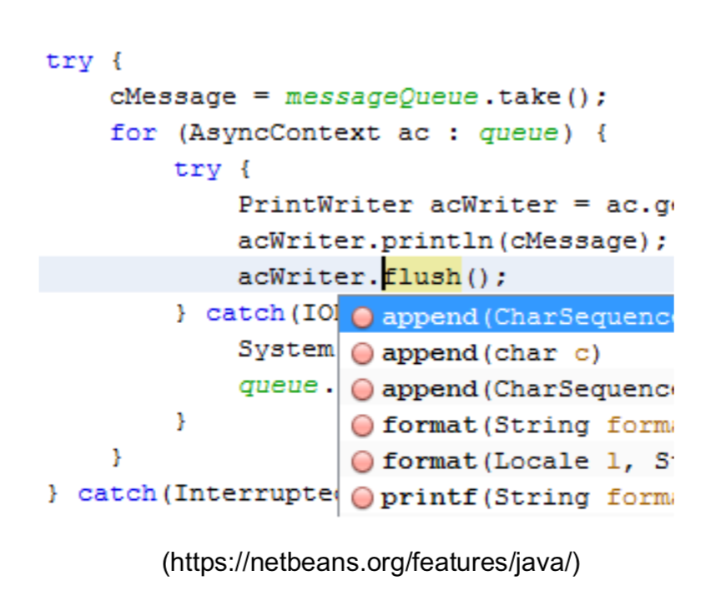
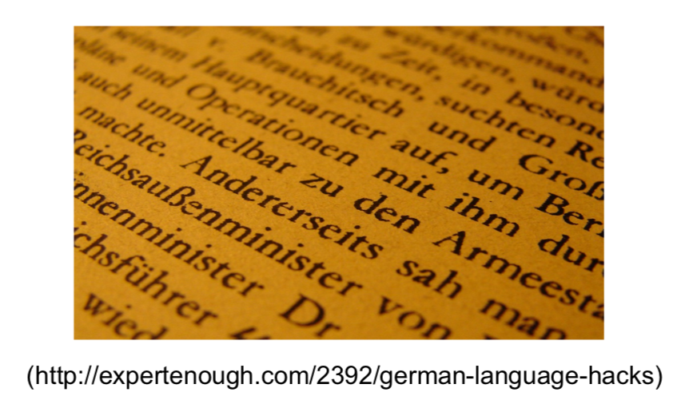
Human and artificial languages
Human language
Artificial language

Slide 8
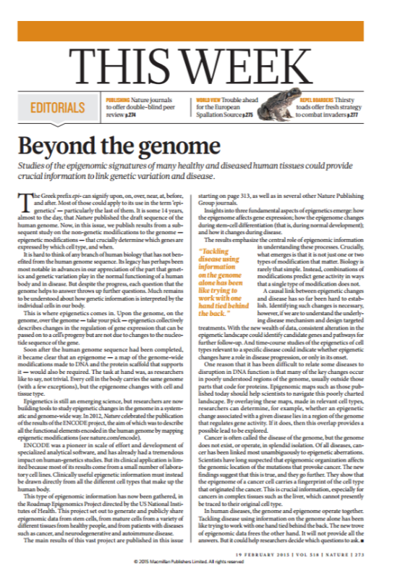
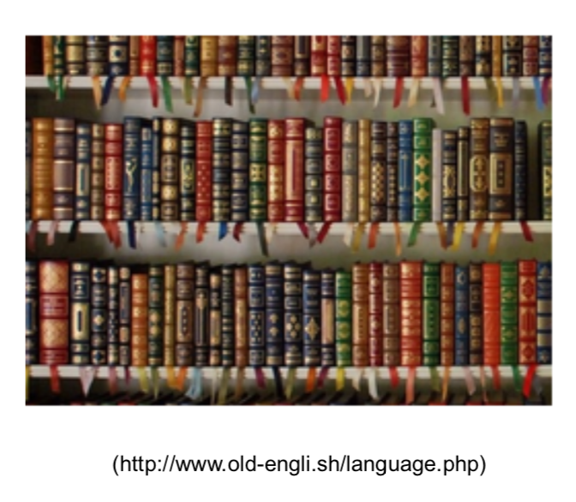
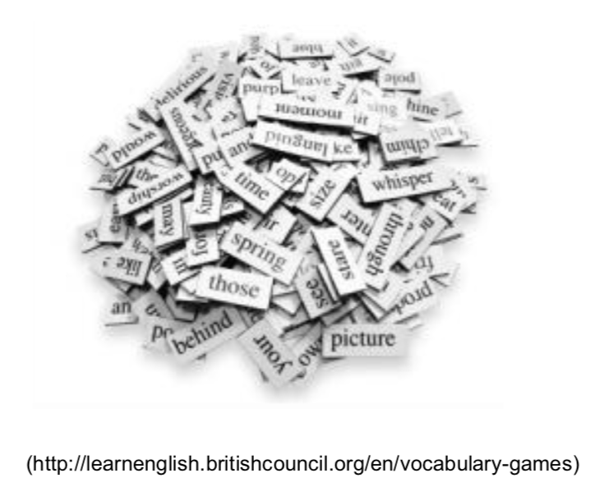
Language
Vocab and grammar
Document
Language

Slide 9
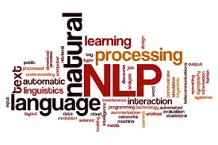
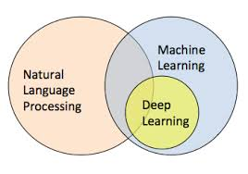
Natural language processing
To process and understand natural languages
Data
Text or speech
Techniques: machine learning (ML)
ACL
JML
ECML
TACL
SIGIR
EMNLP
ECIR
ICML
ACML
CoNLL
AAAI
JCL
CIKM
IJCAI
COLING
CICLING
ICLR
NISP
Main venues of NLP
Virtual assistant
Machine translation

Slide 10
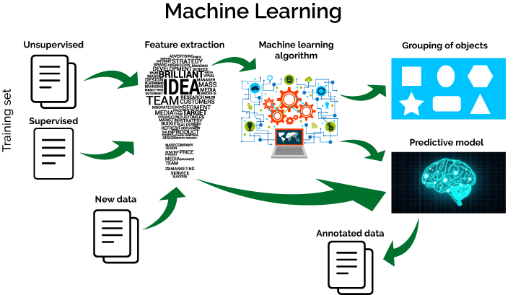
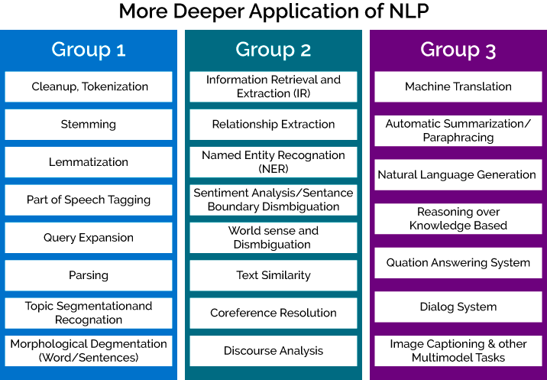
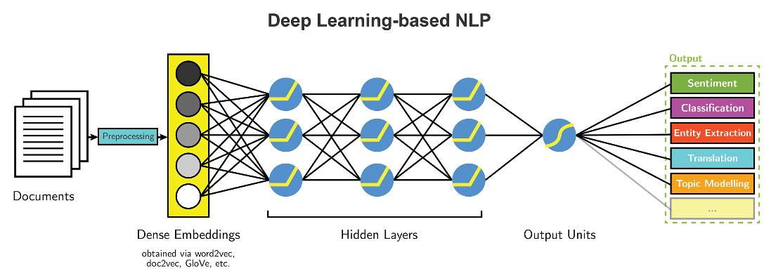
NLP and ML

Slide 11
challenges
Different words with the same meaning (paraphrasing)
Season of the year: Fall or Autumn
Book delivery time:
When will my book arrive?
When will I receive my book?
Ambiguity
Fall
A season of the year or the fall of an object?
Pronunciation
There– their; here – hear, …
Syntax and ambiguity
I saw the man with a telescope → who had the telescope?

Slide 12
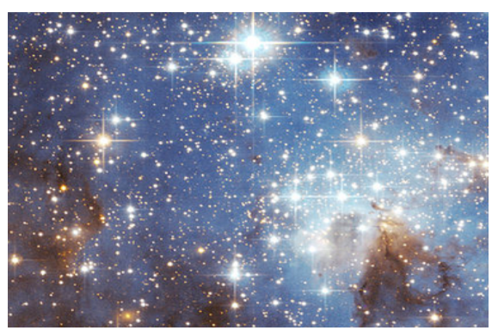
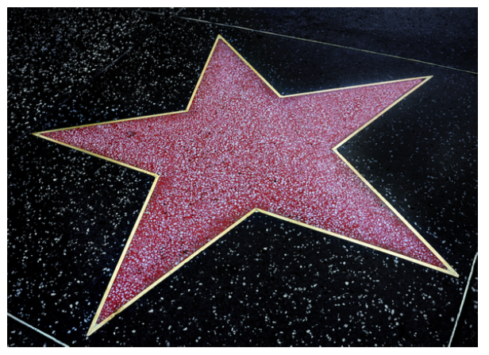
challenges
Semantics
The astronomer loves the star
Star in the sky
Celebrity
Discourse analysis
Alice understands that you like your mother, but she
She: refers to Alice or her mother

Slide 13
Question Answering systems
http://start.csail.mit.edu/index.php

Slide 14
Machine reading comprehension

Slide 15
Neural Machine reading comprehension

Slide 16
Relevant techniques
Text pre-processing
Sentence and word segmentation, parsing, NER
Question analysis
Question classification
Question formulation
Query expansion
Information retrieval
Text representation
Text similarity
Elastic search
Answer generation
NER
Answer generation

Slide 17
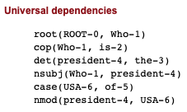
Text pre-processing
Who is the president of USA
Named entity
recognition
Word segmentation
Tagging and Parsing
Algorithms
NLTK
Standford Core NLP
Algorithms
NLTK
Standford Core NLP
Algorithms
NLTK
Standford Core NLP
A set of words
USA
https://corenlp.run

Slide 18
Text pre-processing
Example

Slide 19
Question analysis
Who is the president of USA
Query expansion
Question classification
Question formulation
Algorithms
Algorithms
Algorithms
WordNet
The type of a question
WHO
Creating a query
(Who, president, USA)
(Who, president, USA)

Slide 20
Question classification
Need to understand what users want
Similar to intent detection of chatbot
DIET (Dual Intent Entity Transformers from Rasa)
Two methods
Machine learning
And ???
The evaluation of question classification
Precision, recall, and F-score

Slide 21
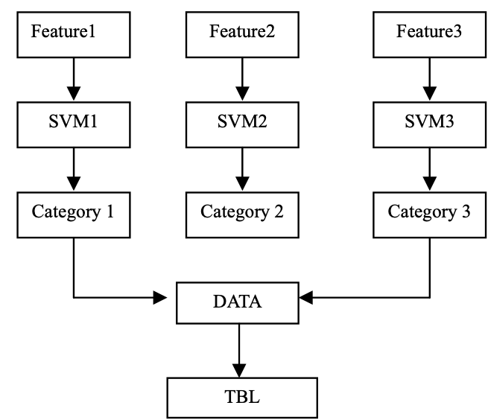
Machine learning method
https://www.aclweb.org/anthology/I05-4009.pdf

Slide 22
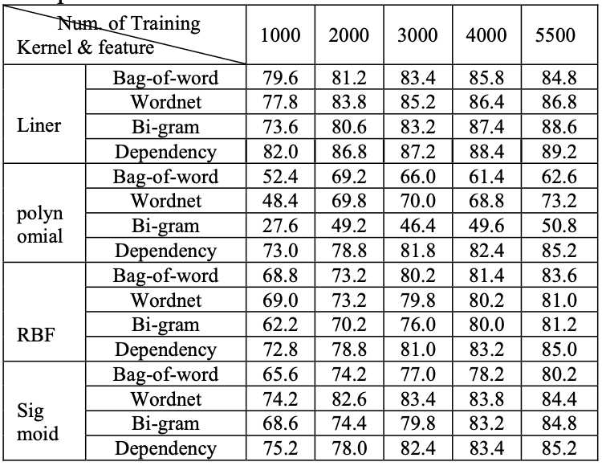
features
https://www.aclweb.org/anthology/I05-4009.pdf

Slide 23
Other methods
Discuss to have another method
Example of question classification

Slide 24
Query creation
A question type
WHO, WHERE, WHEN
WHAT, WHY, HOW
Entities
USA
Relationship
Is–a; a-part-of; sub-class; …
Who (president, is - a, USA)
Who is the president of USA
Question type
Is - a
Entity

Slide 25
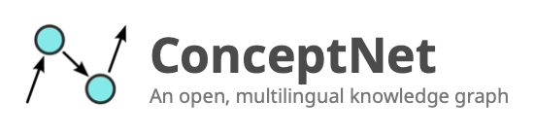
Query Expansion
To extend the query
Increase the recall of the query
Technique
Synonym
WordNet or knowledge graphs
premier
Chief of state
America
Who is the president of USA
Question type
Is - a
Entity

Slide 26
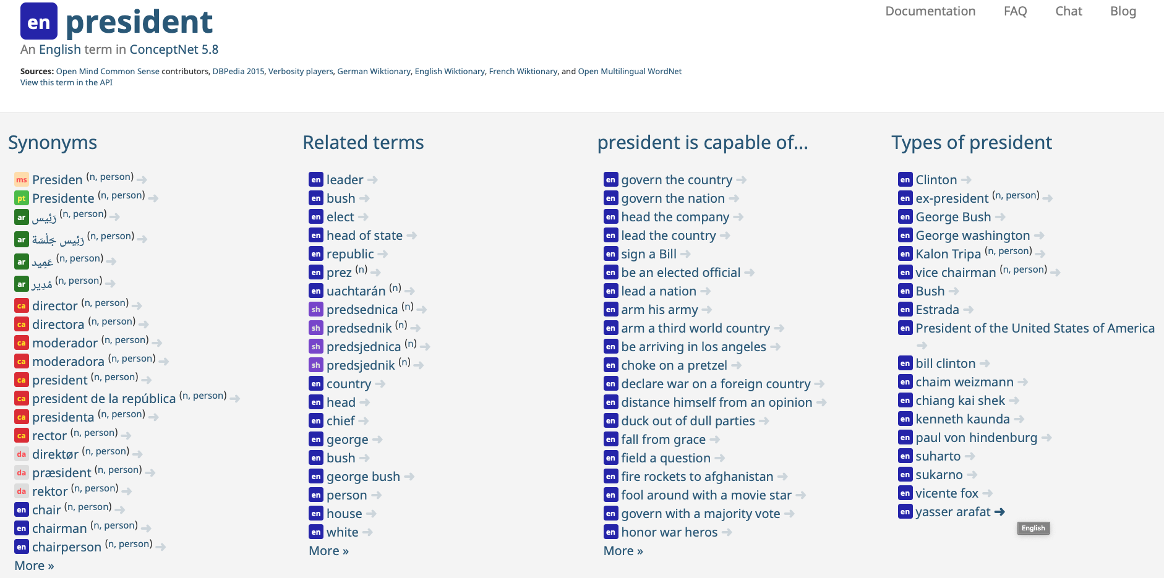
Conceptnet

Slide 27
Information retrieval
Introduction
Indexing
Text representation
Similarity
Elastic search

Slide 28
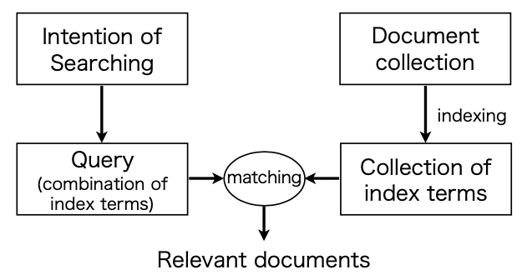
introduction
Information retrieval (IR)
Matching with index term
Find documents relating to an user’s query

Slide 29
indexing
Procedure to extract index terms from documents
Indexing should be done automatically
The number of documents is large
Should not index stopwords
Morphological analysis is required
Unit of index terms
Word (cake, recipe, ingredient)
Phrase (recipe for cake, ingredient of cake)
Difficult to decide appropriate units
In general, words are used as index terms
WHY???

Slide 30
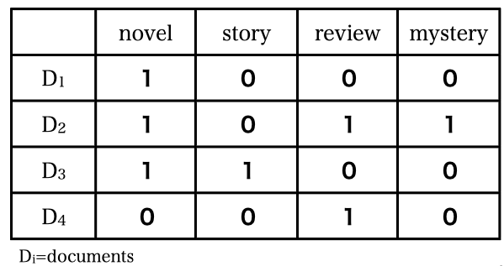
Inverted index
Construct a list of index terms for each document

Slide 31
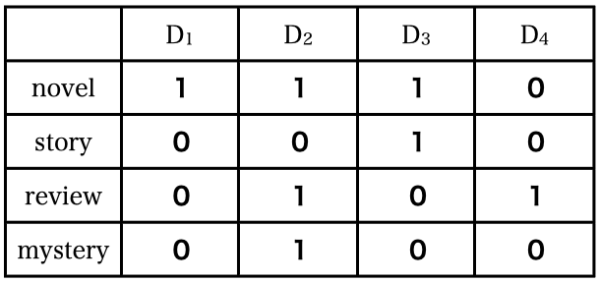
Inverted matrix
We can know a list of documents containing a certain index term

Slide 32
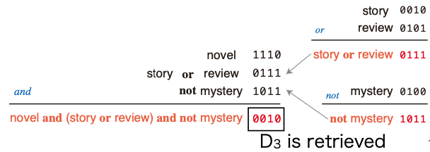
Inverted index
When a query is given in a logical form
Row in inverted index is regarded as a vector
Documents are retrieved by bitwise operation on vectors
The query
Novel and (story or review) and not mystery

Slide 33
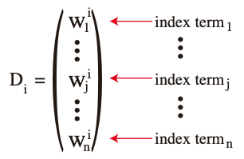
Vector space model (SVM)
Both documents and queries are represented by vectors
Document vector = D_{i}, query vector = Q
Calculating the similarity between two vectors
The most similar document with Q is retrieved
Vector
W_{j}^{i} is a weight of index term

Slide 34
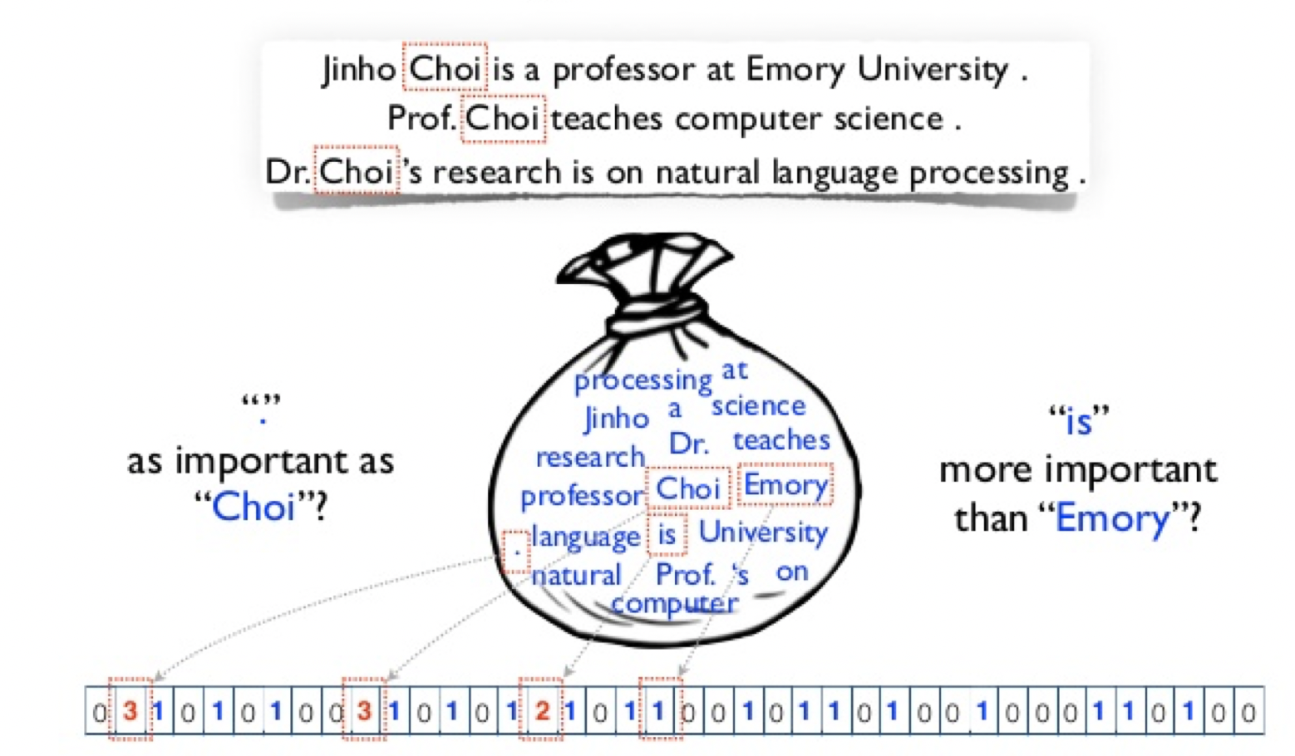
Bag-of-words weighting
Are all words equally important?

Slide 35
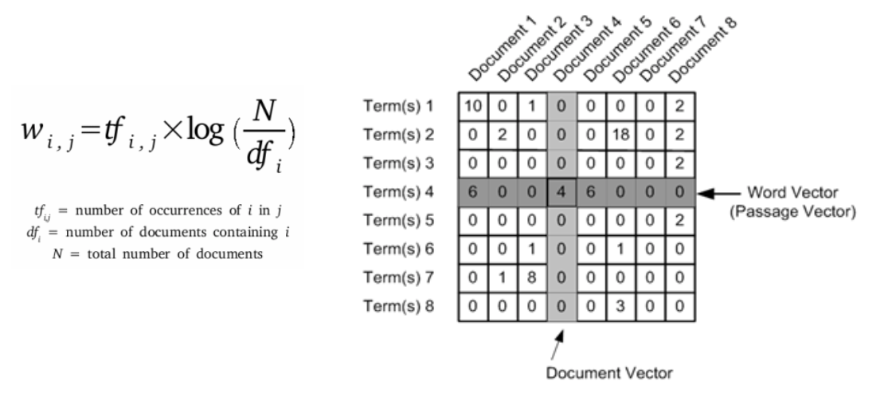
TF-IDF
Term frequency – inverse document frequency
Estimating the importance of words

Slide 36
TF-IDF Example
I love NLP
NLP is challenging
Cinnamon opens a boot camp of NLP

Slide 37
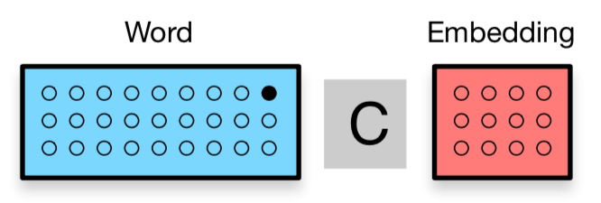
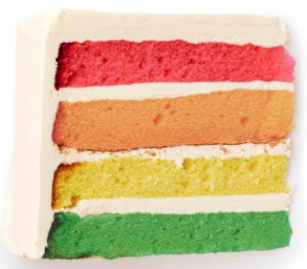
Word embedding
By-product: embedding of words into continuous space
Similar context → similar
Semantic relationship
Apple: [1.11, 2.24, 7.88]
Orange: [1.01, 2.04, 7.22]
Car: [8.41, 2.34, -1.28]
Table: [-1.41, 7.34, 3.01]

Slide 38
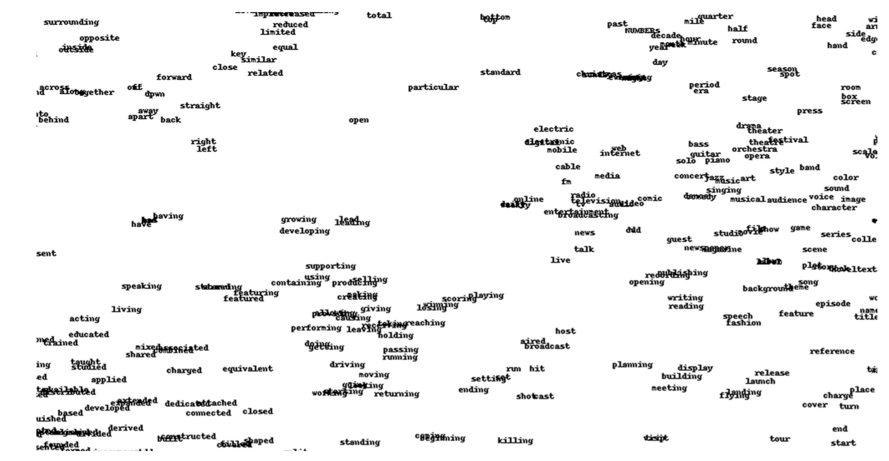
Visualization

Slide 39
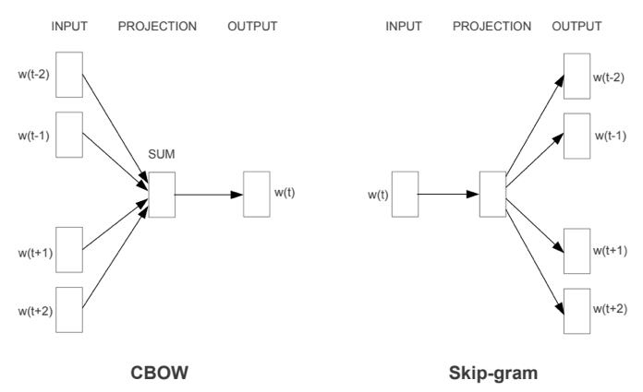
Word2vec: cbow vs. skip-gram
“The word vector encodes semantic relationship among words”
Efficient Estimation of Word Representations in Vector Space (Tomas et al., 2013)

Slide 40
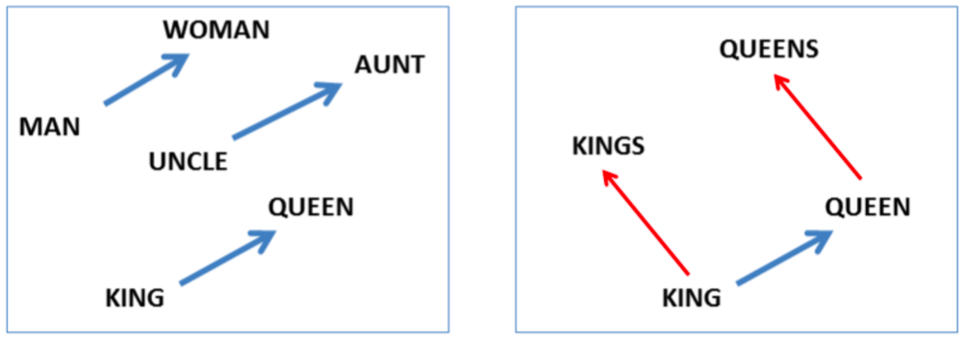
Word2vec
Trained on Google News with 100 billion words
Skip-gram model with the size of 300

Slide 41
Word2vec for document representation
Query
Word2Vec
Cosine()
Inner product()
Document

Slide 42
Elastic search
A platform for IR
Indexing documents
Provide a set of retrieval metrics
BM25
TF-IDF
Homework
Install ElasticSearch and experience

Slide 43
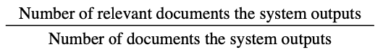
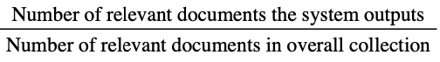
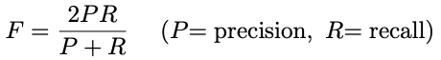
IR evaluation
Precision
Recall
F-score

Slide 44
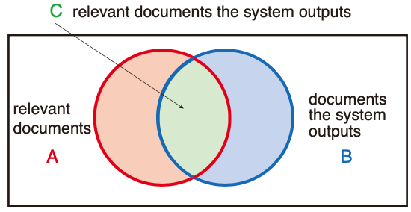
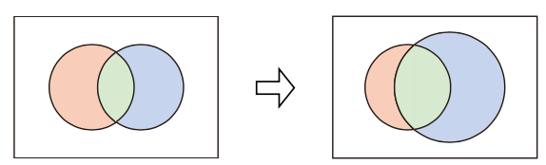
Precision and recall
Precision = C/B
Recall = C/A
Trade-off

Slide 45
Answer extraction
Utilize the techniques of information extraction
Patten matching
Difficult to prepare patterns in advance
Patterns can be generate from a question
Q: ”Who is the president of USA”
A: The president of USA is <ANSWER>
Named entity recognition (NER)
In the presidential election of 2016, Republican Donald Trump was elected …
OTHERS
PEOPLE

Slide 46
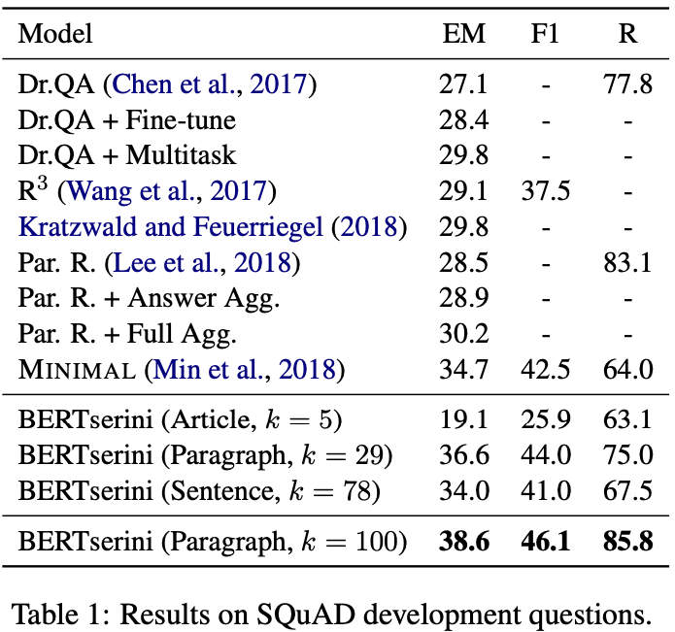
QA and MRC with deep learning
End-to-End Open-Domain Question Answering with BERTserini

Slide 47
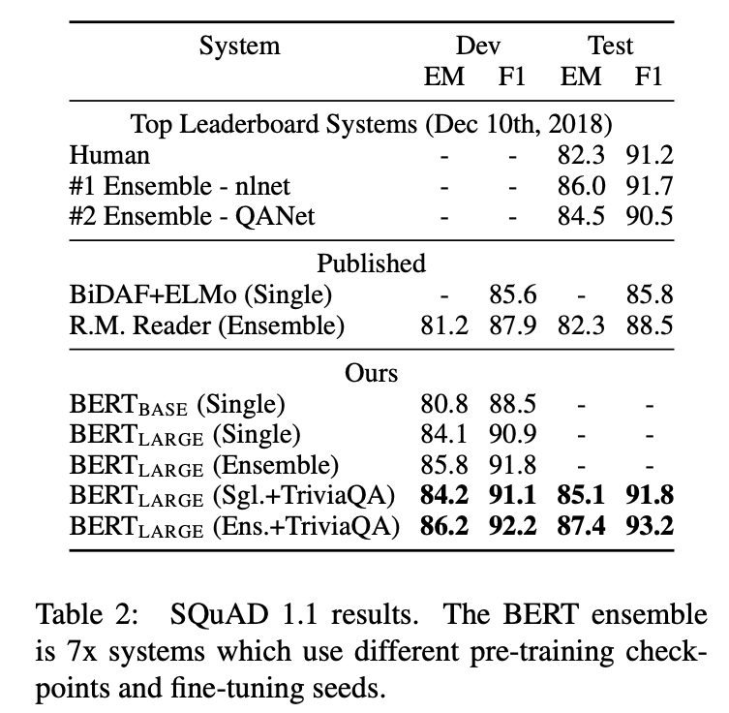
QA and MRC with deep learning
BERT: Pre-training of Deep Bidirectional Transformers for Language Understanding

Slide 48
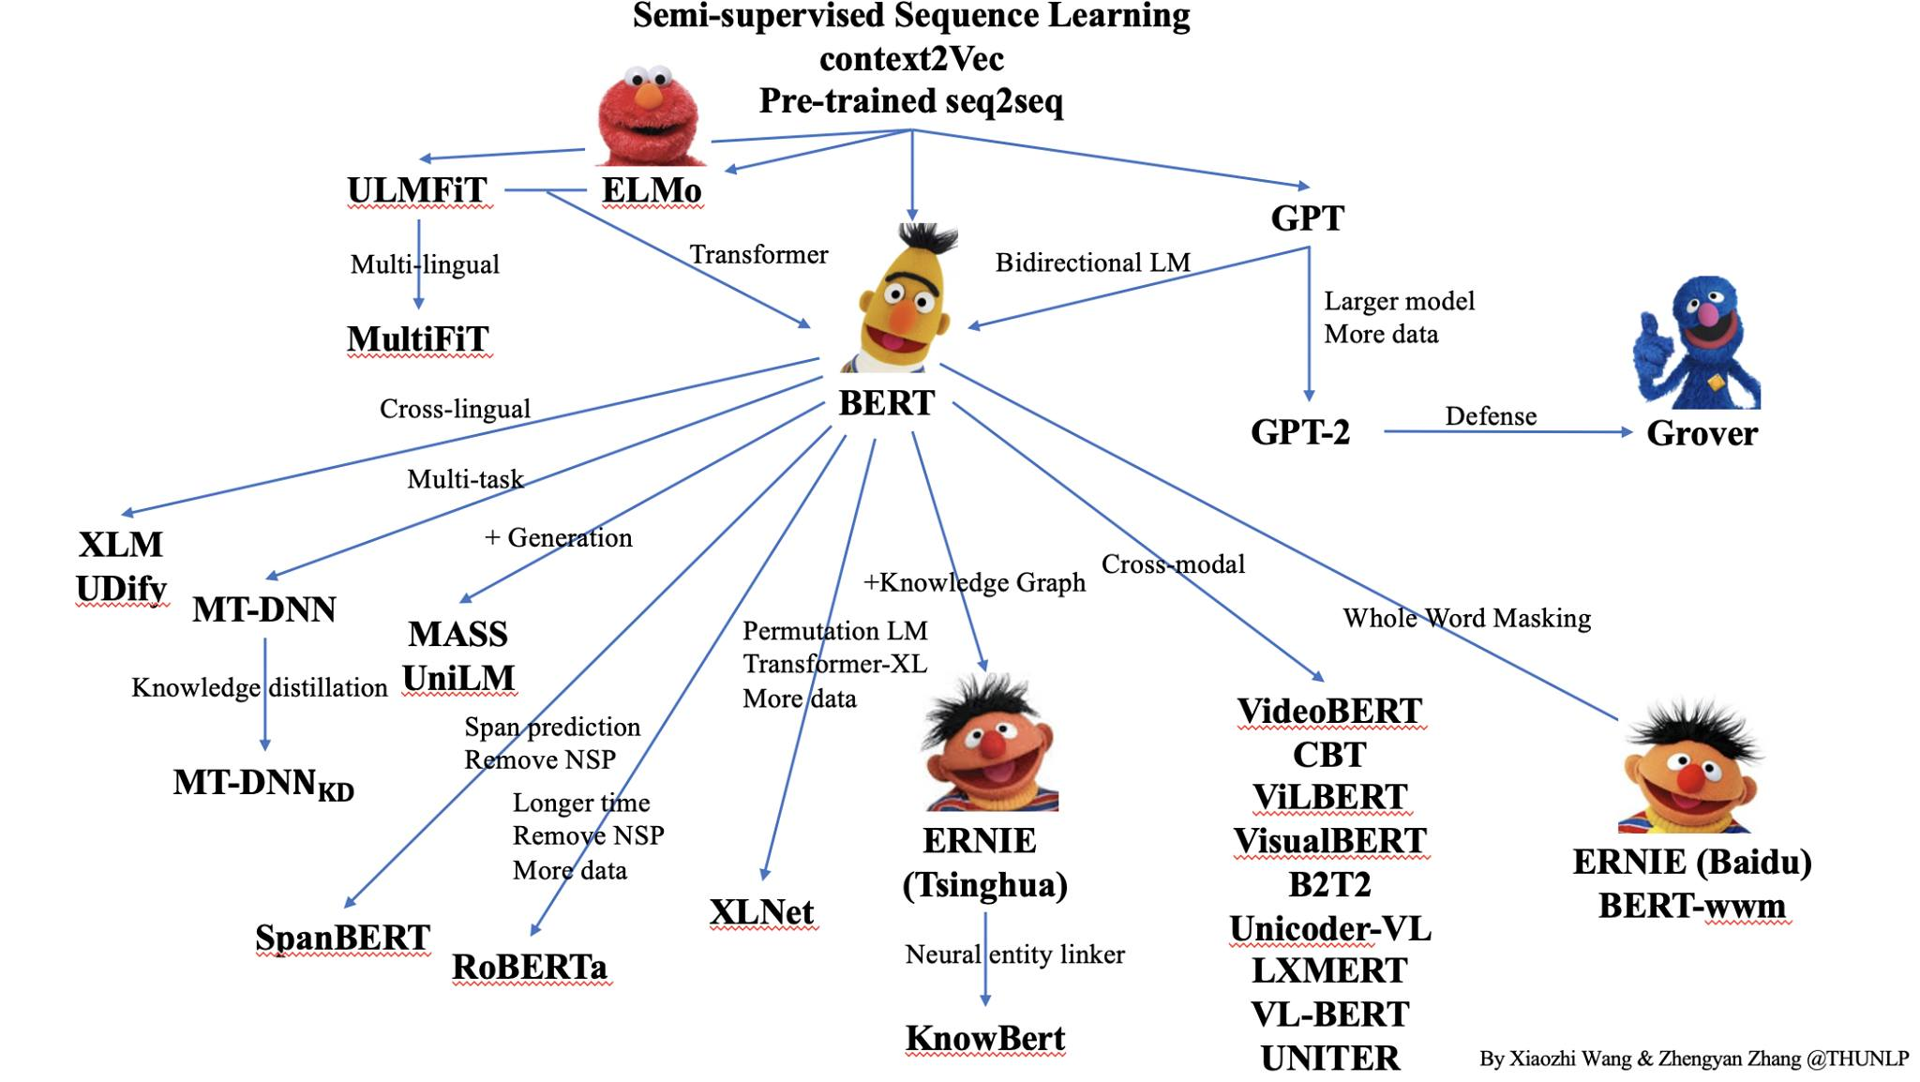
Transformers

Slide 49
Conclusion
Question answering and machine reading comprehension is a challenging task of NLP
A QA system
Question understanding
Information retrieval
Answer extraction
MRC
Based on transformers
Promising results on the SQuAD dataset
Transformers
BERT, DistilBERT, ALBERT, ELECTRA

Slide 50
QA
Thank you!

